Slide 1

SQL Constraints & Functions

Slide 2
Agenda
SQL Constraints
Constraint with ALTER
Where clause
Predicates
- Wildcard Filtering
Set Operations
Duplicate rows
Operator precedence
SQL Built-in function

Slide 3
SQL Constraints
SQL constraints are used to specify rules for data in a table
Constraints can be specified when the table is created with the CREATE TABLE statement
Syntax:
CREATE TABLE table_name (
column1 datatype constraint,
column2 datatype constraint,
column3 datatype constraint,
....);

Slide 4
SQL Constraints
The following constraints are commonly used in SQL
Constraints | Meaning
NOT NULL | Ensures that a column cannot have a NULL value
UNIQUE | Ensures that all values in a column are different
PRIMARY KEY | A combination of a NOT NULL and UNIQUE. Uniquely identifies each row in a table

Slide 5
SQL Constraints
Constraints | Meaning
FOREIGN KEY | Uniquely identifies a row/record in another table
CHECK | Ensures that all values in a column satisfies a specific condition
DEFAULT | Sets a default value for a column when no value is specified
INDEX | Used to create and retrieve data from the database very quickly

Slide 6
Not Null-Constraint

Slide 7
SQL NOT NULL Constraint
By default, a column can hold NULL values
The NOT NULL constraint enforces a column to NOT accept NULL values
This enforces a field to always contain a value
You cannot insert a new record, or update a record without adding a value to this field

Slide 8
SQL NOT NULL on CREATE TABLE
The following SQL ensures that the "id", "first_name", and "last_name" columns will NOT accept NULL values:
CREATE TABLE customers ( id int Not Null
first_name varchar(20) Not Null
last_name varchar(20) Not Null
country varchar(20)
);

Slide 9
Unique - Constraint

Slide 10
SQL UNIQUE Constraint
The UNIQUE constraint ensures that all values in a column are different.
A PRIMARY KEY constraint automatically has a UNIQUE constraint.
You can have many UNIQUE constraints per table, but only one PRIMARY KEY constraint per table

Slide 11
SQL UNIQUE Constraint on CREATE TABLE
The following SQL creates a UNIQUE constraint on the "ID" column when the "company" table is created:
CREATE TABLE customers ( id int Not Null UNIQUE,
first_name varchar(20) Not Null,
last_name varchar(20) Not Null,
country varchar(20)
) ;

Slide 12
Primary Key-Constraint

Slide 13
SQL PRIMARY KEY Constraint
The PRIMARY KEY constraint uniquely identifies each record in a table
Primary keys must contain UNIQUE values, and cannot contain NULL values
A table can have only ONE primary key

Slide 14
SQL PRIMARY KEY Constraint on CREATE TABLE
The following SQL creates a PRIMARY KEY on the "id" column when the "customers" table is created:
CREATE TABLE customers ( id int Not Null,
first_name varchar(20) Not Null,
last_name varchar(20) Not Null,
country varchar(20),
PRIMARY KEY (id)
);

Slide 15
Foreign Key - Constraint

Slide 16
SQL FOREIGN KEY Constraint
A FOREIGN KEY is a key used to link two tables together
It is a field (or collection of fields) in one table that refers to the PRIMARY KEY in another table
The table containing the foreign key is called the child table
The table containing the candidate key is called the referenced or parent table

Slide 17
SQL FOREIGN KEY Constraint - Data
CustomerID | First name | Last name | country
1 | Mike | Christensen | USA
2 | Andy | Hollands | Australia
3 | Ravi | Vedantam | India
Customer table
OrderID | OrderNumber | CustomerID
1 | 56675 | 3
2 | 74498 | 3
3 | 85467 | 2
4 | 42986 | 1
Orders table

Slide 18
SQL FOREIGN KEY Constraint
Notice that the "CustomerID" column in the "Orders" table points to the "CustomerID" column in the "Customer" table
The "CustomerID" column in the "Customer" table is the PRIMARY KEY in the "customer" table
The "CustomerID" column in the "Orders" table is a FOREIGN KEY in the "Orders" table

Slide 19
SQL FOREIGN KEY Constraint
The FOREIGN KEY constraint is used to prevent:
actions that would destroy links between tables
invalid data being inserted into the foreign key column, because it has to be one of the values contained in the table it points to

Slide 20
SQL FOREIGN KEY on CREATE TABLE
The following SQL creates a FOREIGN KEY on the "CustomerID" column when the "Orders" table is created:
CREATE TABLE Orders ( OrderID int NOT NULL,
OrderNumber int NOT NULL,
customerID int,
PRIMARY KEY (OrderID),
FOREIGN KEY (CustomerID)
REFERENCES Customer(CustomerID)
);

Slide 21
Constraint using ALTER

Slide 22
The Alter Query - Add Clause
Assigning Primary Key Constraint to an Existing Field
To create a PRIMARY KEY constraint on a column when the table is already created, we use the ADD clause with the ALTER command
Syntax:
ALTER TABLE table_name ADD PRIMARY KEY(column_name);

Slide 23
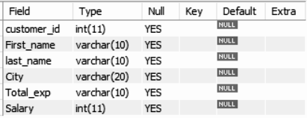
The Alter Query - Add Clause
Consider the previously created table Customer:
Here, we need to declare “customer_id” as primary key

Slide 24
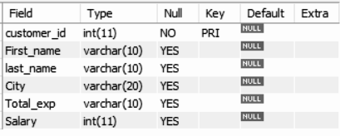
The Alter Query - Add Clause
Use below alter query to add primary key to an existing field ‘customer_id’:
ALTER TABLE Customer ADD PRIMARY KEY(customer_id);
Use describe Customer to check if the primary key has been assigned to the field

Slide 25
The Alter Query - Drop Clause
The Drop clause with the alter command allows you to:
Delete a column from the table
Removing the constraint from a column

Slide 26
The Alter Query - Drop Clause
Dropping the Primary Key Constraint from a Field
To drop a PRIMARY KEY constraint from an already created table, use below syntax
Syntax:
ALTER TABLE table_name DROP PRIMARY KEY_

Slide 27

There is only one Primary Key in a table. Hence, we don’t need to specify the name of the column while dropping the Primary Key using the ALTER command

Slide 28
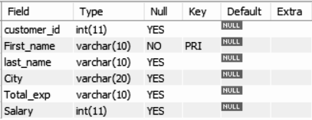
The Alter Query - Drop Clause
Consider a table Customer with below fields:
It would be not be a good practise to declare ‘First_name’ as Primary Key

Slide 29

The Alter Query - Drop Clause
Use below alter query to drop primary key from an already defined primary key field ‘First_name’:
ALTER TABLE Customer DROP PRIMARY KEY;
Use describe Customer to check if the primary key has been drop from the field

Slide 30
Row Selection

Slide 31
Where Clause Predicates
A Where clause predicate is an expression which evaluates to a Boolean value to determine which row or a set of rows are relevant to a particular query
By using predicates in the where clause we can filter out unwanted rows

Slide 32
Where Clause Predicates
The Where Clause supports the following types of predicates :
Comparison
= Equal
<> Not Equal
< Less Than
<= Less Than Or Equal
Pattern Matching
LIKE ( Used for Wildcard Filtering)
BETWEEN
IN
IS NULL

Slide 33
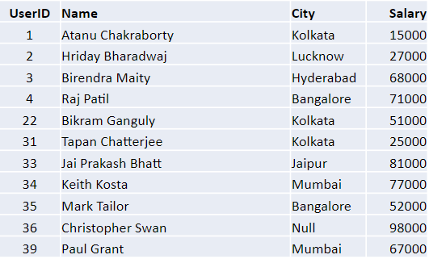
Where Clause Predicates
Consider the table, tblUser, and let us build some query examples using it

Slide 34
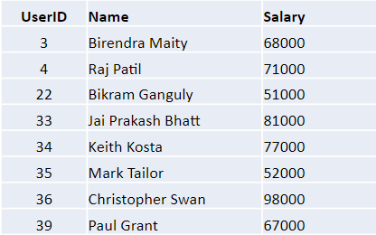
Where Clause Predicates - Comparison Operator
Let’s say you want to retrieve UserID, Name and Salary of users where user’s salary is greater than 50000
SELECT UserID, Name, Salary FROM tblUser Where Salary > 50000
Output:

Slide 35
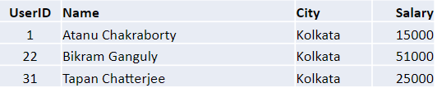
Where Clause Predicates - Comparison Operator
We will use the ‘=’ operator to retrieve records where users belong to Kolkata
SELECT * FROM tblUser WHERE city = 'Kolkata';
Output:

Slide 36
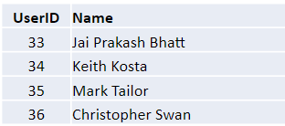
Where Clause Predicates - Between Predicate
BETWEEN predicate is used to select rows within a specified range of values
The below query will display the users whose userID’s are in between 33 and 36:
SELECT UserID, Name FROM tblUser WHERE UserID BETWEEN 33 AND 36;
Output:

Slide 37
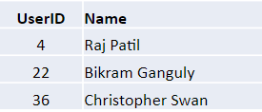
Where Clause Predicates - IN Predicate
IN predicate is used to select rows within a set of specified values
The below query will display the users whose UserIDs are 4, 22 and 36:
SELECT UserID,Name FROM tblUser WHERE UserID IN (4,22,36)
Output:

Slide 38

Where Clause Predicates - IS NULL Predicate
IS NULL is used to select rows if a specified column value contains a null value
For Example:
SELECT * FROM tblUser WHERE City IS NULL
Output:

Slide 39
Where Clause Predicate - Like Predicate

Slide 40
Wildcard Filtering
Wildcard filtering is a method for comparing and displaying texts in a column against a search pattern
Wildcard filtering is generally used in cases when you:
Do not know how to spell someone’s last name, but you know what letter it starts with
Do not know the name of a song but you know the lyrics
Want to search a product based on it’s description in case you don’t remember the product name

Slide 41
Why Use Wildcard Filtering?
Using wildcard in MySQL can increase the performance of an application
It can reduce the time to filter the record from the database
Complex SQL queries can be converted into simple one using wildcards
Using wildcards we can develop powerful search engines in a large data-driven application. Searching in the data-driven application are much more dependent on the use of wildcards

Slide 42
Wildcards
Wildcards are characters that are used to filter/search data from the database on the basis of certain patterns
They are often used with the operators like LIKE and NOT LIKE in conjunction with the WHERE clause

Slide 43
Wildcards
Types of Wildcards:
Type | Description
% | The percent character indicates any character with any number of counts
- | The hyphen character indicates a range of the character within the braces [a-c]
_ | The underscore character indicates any one character
[] | The square bracket indicates any one value with the brackets
^ | The caret character indicates all the character except available in the brackets: [ ^xyz]
# | The hash sign indicates a single numeric character

Slide 44
Wildcards
To carry out the wildcard filtering exercise we use movie lens dataset
Follow the below instructions to load the data in a mysql table:
Download the data using the link:
http://files.grouplens.org/datasets/movielens/ml-latest.zip
Run the query:
SHOW VARIABLES LIKE "secure_file_priv";
copy movies.csv to this folder
(you might get a different value )

Slide 45
Wildcards
Create tables movies:
CREATE TABLE MOVIES(
movieId int,
title varchar(200),
genres varchar(200));
Load the data in table using:
LOAD DATA INFILE 'C:/ProgramData/MySQL/MySQL Server 8.0/Uploads/movies.csv'
INTO TABLE MOVIES FIELDS TERMINATED BY ','
ENCLOSED BY '"'
LINES TERMINATED BY '\n'
IGNORE 1 ROWS;
Run a select query to check if the data is loaded into the table succesfully:
SELECT * FROM MOVIES;

Slide 46
Wildcard Filtering - ‘%’ Wildcard
% wildcard is used in searching or filtering a record by matching any string of zero or more character
It has the following syntax:
SELECT statement...WHERE column_name LIKE ‘xxx%’
Here,
"SELECT statement..." is the standard SQL SELECT command.
"WHERE" is the key word used to apply the filter.
"LIKE" is the comparison operator that is used in conjunction with wildcards
'xxx' is any specified starting pattern such as a single character or more and "%" matches any number of characters starting from zero (0).

Slide 47
Wildcard Filtering - ‘%’ Wildcard
% can be used either in the first place, in the last or at both side of the string
If used in the first place (“%xxx”), all those rows will be extracted from the database where the column will contain strings ending with ‘xxx’
If used at both the ends (“%xxx%”), all those rows will be extracted from the database where the column will contain the string ‘xxx’ anywhere in the column string
If used at the last (“xxx%”), all those rows will be extracted from the database where the column will contain string starting with ‘xxx’

Slide 48
Wildcard Filtering - ‘%’ Wildcard
Let us understand these usage one-by-one with examples
Scenario - 1
Suppose you forgot the complete name of the movie that you finished watching a few days ago, say, “Eternal Sunshine of the Spotless Mind”. You only remember that the name started with the word “Eternal”
Searching each and every movie in the database will not be a good option

Slide 49
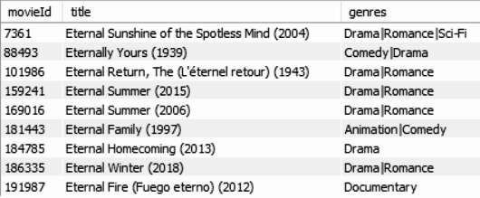
Wildcard Filtering - ‘%’ Wildcard
Below is the SQL statement that can help you filter records
SELECT * FROM movies WHERE title LIKE 'eternal%';
You can now easily recall the name of the movie by looking at the above output

Slide 50
Wildcard Filtering - ‘%’ Wildcard
The query translates to:
Select all the columns from the Movies table
Return the rows whose title begins with the string 'eternal' and is followed by zero or more occurrences of any character

Slide 51
Wildcard Filtering - ‘%’ Wildcard
Scenario - 2
You are a Harry Potter fan and want to know the name of all the Harry Potter movies that are not based famous book series
The only information that you have is that the name of all the Harry Potter movies based on the books started with the string Harry Potter . But is there any other movie based on Harry Potter?

Slide 52
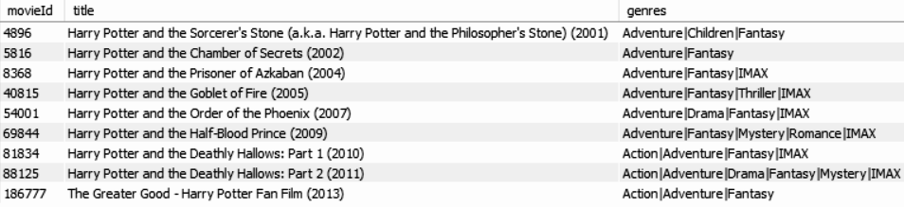
Wildcard Filtering - ‘%’ Wildcard
Below is the SQL statement that can help you take a look at all the movie titles based-on Harry Potter
SELECT * FROM movies WHERE title LIKE '%harry potter%';
There is one movie in the list, ‘The Greater Good - Harry Potter Fan Film’, which is not based on the Harry Potter book

Slide 53
Wildcard Filtering - ‘%’ Wildcard
Scenario - 3
You are a kind of person who loves to watch movies across all genres. Among all the genres, you find the ‘film noir’ genre intriguing
You want to watch all the movies that carries a ‘film noir’ theme from the year 1990
The challenge is we do not have a year column in the movie table. How do we retrieve those movies that belong to the ‘film noir’ category from the year 1990?

Slide 54
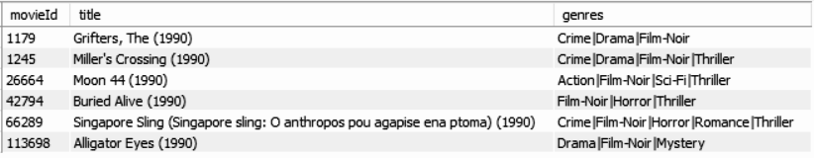
Wildcard Filtering - ‘%’ Wildcard
Below is the SQL statement that can help you take a look at all film-noir movies from the year 1990
SELECT * FROM movies WHERE genres LIKE '%film-noir%' AND title LIKE "%1990%"
Notice that we have used two conditions here where we have used the ‘%’ at both the ends of the string

Slide 55
Wildcard Filtering - ‘_’ (underscore) Wildcard
The underscore(_) wildcard is used to match exactly one character
It has the following syntax:
SELECT statement...WHERE column_name LIKE ‘xxx_’
Here,
"SELECT statement..." is the standard SQL SELECT command
"WHERE" is the key word used to apply the filter
"LIKE" is the comparison operator that is used in conjunction with wildcards
'xxx' is any specified starting pattern such as a single character or more and _ matches the string with only one characters

Slide 56
Wildcard Filtering - ‘_’ (underscore) Wildcard
_ can be used either in the first place, in the last or at both side of the string
If used in the first place (“_xxx”), all those rows will be extracted from the database where the instance of column will contain string that starts with any single character and ends with ‘xxx’
If used at both the ends (“_xxx_”), all those rows will be extracted from the database where the column will contain the string ‘xxx’ that starts and ends with any single character
If used at the last (“xxx_”), all those rows will be extracted from the database where the column will contain string starting with ‘xxx’ followed by any single character
You can use n number of underscore character for matching n number of character

Slide 57
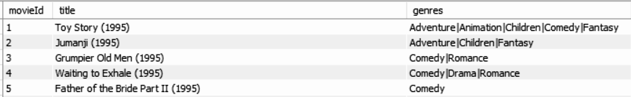
Wildcard Filtering - ‘_’ (underscore) Wildcard
Let us understand these usage one-by-one with examples
Scenario - 1
Consider the movies table
Most of the movie in the table are cross-genre (blended genres) movies

Slide 58
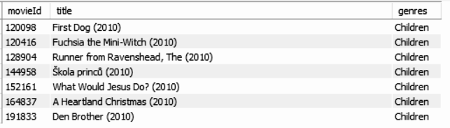
Wildcard Filtering - ‘_’ (underscore) Wildcard
You want to retrieve the name of all the movies that are not cross genre movies but are pure genre movie, say just the children category, from the year 2010
Below is the SQL statement that can help you take a look at all the movie names from the year 2010 that belongs only to the children category
SELECT * FROM movies WHERE genres LIKE "children_" AND title LIKE '%2010%';

Slide 59
Wildcard Filtering - NOT Logical Operator
The NOT logical operator can be used together with the wildcards to return rows that do not match the specified pattern
Suppose we want to retrieve movies that were not released in the year 1900s
We would use the NOT logical operator together with the underscore as well as the percent wildcard to get our results ( Yes!! You can use combination of wildcards)

Slide 60
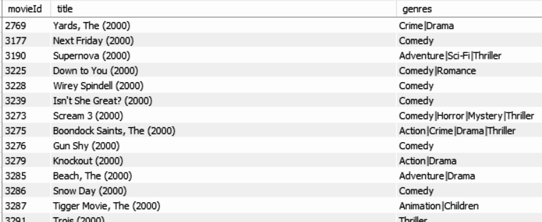
Wildcard Filtering - NOT Logical Operator
Below is the script that retrieves movie name not belonging to 1900s
SELECT * FROM movies WHERE title NOT LIKE '%19__%';
Notice that we have used two percent operator at both the ends and two underscore operators right after ‘19’

Slide 61
Wildcard Filtering - Escape operator
The ESCAPE keyword is used to escape pattern matching characters such as the (%) percentage and underscore (_) if they form part of the data.
For example, movies like 100% Love has the % symbol in its title, if we try to search the name of such movies using wildcard filtering the % in the title would be treated as wildcard
To make such characters treated as string, we use the ESCAPE keyword

Slide 62
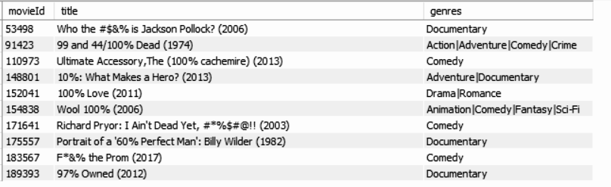
Wildcard Filtering - NOT Logical Operator
We use below query to retrieve movie name that has the % character in its name:
SELECT * FROM movies WHERE title LIKE '%#%%' ESCAPE '#';
Here note the double "%%" in the LIKE predicate, the first one in red "%" is treated as part of the string to be searched for. The other one is used to match any number of characters that follow

Slide 63
Wildcard Filtering - Summary
The LIKE predicate & WILDCARDS are powerful tools that help search data matching complex patterns
The percentage ( % ) wildcard is used to match any number of characters starting from zero (0) and more characters
The underscore ( _ ) wildcard is used to match exactly one character

Slide 64
Set Operations

Slide 65
Set Operations
Set operators are used to join the results of two (or more) SELECT statements
Types of SET operations:
UNION
UNION ALL
INTERSECT
MINUS

Slide 66
Set Operations - Union
The Union clause/operator is used to combine the results of two or more SELECT Statements with Identical columns without returning any duplicate rows
Syntax:
SELECT col1, col2, col3 FROM tables [WHERE conditions]
UNION
SELECT col1, col2, col3 FROM tables [WHERE conditions];
There should be same number of columns in both SELECT statements
The column names from the first SELECT statement in the UNION operator are used as the column names for the result set

Slide 67
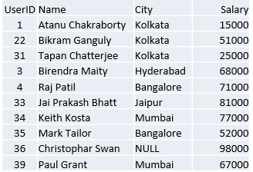
Set Operations - Union
Consider a query to find the names of all users that live in Kolkata and all the users of any city who are getting salary of 50000 and above
Let us design the query and examine the result.
SELECT UserID, Name, City, Salary FROM tblUser WHERE City = 'Kolkata'
UNION
SELECT UserID, Name, City, Salary FROM tblUser WHERE Salary >= 50000;
Output:

Slide 68
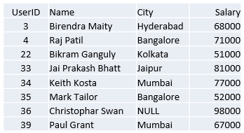

Set Operations - Union
Let us run both the queries and check the results
First Query:
Second Query:
SELECT UserID, Name, City, Salary FROM tblUser
WHERE City = 'Kolkata';
SELECT UserID, Name, City, Salary
FROM tblUser
WHERE Salary >= 50000;
Output:
Output:

Slide 69
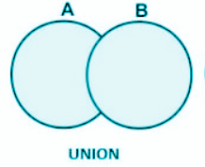
Set Operations - Union
In the result we can see UserID 22 appeared once but if we look into the query both query returns the same row if they run individually but while in the UNION operation they returned only once
This is because the Union clause works just like the Union operation in Set theory where the duplicate members appear only once in the resultant set.

Slide 70
Set Operations - Union All
The Union All clause/operator is used to combine the results of two or more SELECT Statements into a single set of rows and columns without the removal of any duplicates
Syntax:
SELECT col1, col2, col3 FROM tables [WHERE conditions]
UNION ALL
SELECT col1, col2, col3 FROM tables [WHERE conditions];

Slide 71
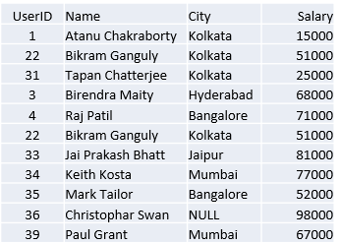
Set Operations - Union All
Consider a query to find the names of all users that live in Kolkata and all the users of any city who are getting salary of 50000 and above
Let us design the query and examine the result.
SELECT UserID, Name, City, Salary FROM tblUser WHERE City = 'Kolkata'
UNION ALL
SELECT UserID, Name, City, Salary FROM tblUser WHERE Salary >= 50000;
Output:

Slide 72
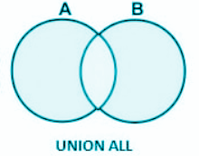
Set Operations - Union All
The result of both the select statements are combined into single set of rows and columns WITHOUT the removal of duplicates
UserID 22 appears twice the view

Slide 73

Set Operations - Intersect
The INTERSECT OPERATION is used to combine two SELECT statements with identical columns and returns rows only common rows returned by the two select statements
We can use the intersect operations to display records where city is Kolkata and salary is greater than or equal to 50000

Slide 74
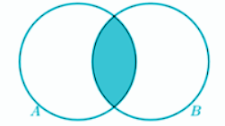
Set Operations - Intersect
In the result we can see UserID 22 is the common observation in the given two tables
Intersect operates similar to intersect operation from set theory

Slide 75
MySQL DOES NOT support INTERSECT operator. However, you can emulate the INTERSECT operator using JOINS. We will study joins in the upcoming sessions.

Slide 76

Set Operations - Minus
The MINUS OPERATION combines results of two SELECT statements and return only those in the final result, which belongs to the first set of the result

Slide 77
MySQL DOES NOT support MINUS operator. However, you can emulate the MINUS operator using JOINS. We will study joins in the upcoming sessions.

Slide 78
Duplicate Rows

Slide 79
Duplicate Rows
Duplicate rows, or duplicate records, are identical rows in a table.
It is not desired that a relation or a table have duplicate records
Several constraints (e.g. Primary Key, Candidate Key, Unique Key etc.) during the database design phase can be used to avoid duplicate records
There are still unavoidable situations where duplicate records get stored in the table
For example, when a staging table is used and data is loaded from different sources, duplicate rows are possible

Slide 80
Duplicate Rows
The DISTINCT keyword in the SELECT statement eliminates duplicate rows and display a unique list of values
Syntax:
SELECT DISTINCT column_list FROM table_name

Slide 81
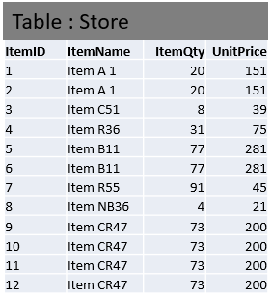
Duplicate Rows
Consider the table below:
Here the column ItemID is considered as a primary key and is a auto generated column which means the field values are not supplied from any outside source, rather they are generated automatically and the values are stored in a sequentially incremental fashion
Hence we do not have any control over that column values but other column values are supplied from outside sources
The set of rows {1, 2}, {5,6} and {9,10,11,12} are duplicate

Slide 82
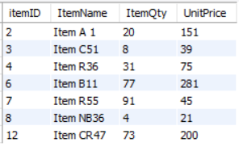
Duplicate Rows
Use a below SELECT statement to get all the unique observations
Query:
Output:
SELECT DISTINCT * FROM Store
The above view has no duplicate rows

Slide 83
Operator Precedence

Slide 84
Operator Precedence
Consider the below Employee table:
ID | NAME | AGE | ADDRESS | SALARY
1 | Kellie | 32 | California | 2000
2 | Pete | 25 | Texas | 1500
3 | Popy | 23 | Boston | 2000
4 | Sam | 25 | Florida | 6500
5 | Jhon | 27 | Hawaii | 10000

Slide 85


Write a query to display employees having salary greater than 1800 and whose name starts with either ‘s’ or ‘p’
SELECT * FROM Employee
WHERE Salary > 1800 and Name like 's%' or Name like 'p%';
Output:
This query displays employee whose salary is less than 1800 in the result. This is due to the higher precedence of AND as compared to OR

Slide 86
Operator Precedence
Operator precedence specifies the order in which operators are evaluated when two or more operators with different precedence are adjacent in an expression
These operator precedence rule greatly affects MySQL queries

Slide 87

Operator Precedence
To display employees having salary greater than 1800 and whose name starts with either ‘s’ or ‘p’, we write the below query:
SELECT * FROM Employee
WHERE Salary > 1800 and (Name like 's%' or Name like 'p%');
Output:

Slide 88
Operator Precedence
Operator precedences are shown in the following list, from highest precedence to the lowest. Operators that are shown together on a line have the same precedence
# | Operator | Description
1 | INTERVAL | Return the index of the argument that is less than the first argument
2 | BINARY, COLLATE | Binary: This is a type that stores binary byte strings Collate: This clause override whatever the default collation is for comparison
3 | ! | Negate values
4 | - (unary minus), ~ (unary bit inversion) | Unary Minus: It change the sign of the operand Unary Bit Inversion: It inverts the bits of operand

Slide 89
Operator Precedence
# | Operator | Description
5 | ^ | Bitwise XOR
6 | *, / , % | *: Multiplication operator / : Division operator %: Modulo Operator
7 | -, + | - : Minus Operator + : Plus Operator
8 | <<, >> | << : Shift a (BIGINT) number or binary string to left >> : Shift a (BIGINT) number or binary string to right

Slide 90
Operator Precedence
# | Operator | Description
9 | & | Bitwise AND
10 | | | Bitwise OR
11 | =, <=>, >=, >, <=, <, <>, !=, IS, LIKE, REGEXP, IN | = : Comparison Operator <=> : NULL-safe equal to Operator >= : Greater than or equal to > : Greater than <= : Less than or equal to < : Less than <> , != : Not equal to IS : Test value against a boolean value LIKE : Pattern matching operator REGEXP: Matches the string expression with the regular expression IN : Check whether a value is present in list or not

Slide 91
Operator Precedence
# | Operator | Description
12 | BETWEEN, CASE WHEN, THEN ELSE | BETWEEN: Check whether a value is within a range of values CASE WHEN, THEN ELSE: Case operator
13 | NOT | Negates Value
14 | AND, && | Logical AND
15 | XOR | Logical XOR
16 | OR, || | Logical OR
17 | = (assignment), := | Assign a value

Slide 92
SQL Built-in Functions

Slide 93
SQL Built-in Function
Built in functions are functions that are shipped with MySQL
They can be categorized according to the data types that they operate on i.e. strings, date and numeric built in functions

Slide 94
SQL Built-in Function
There are different types of SQL built - in functions, which are mentioned below:
String
Numeric
Date
Bin
Cast

Slide 95
SQL Built-in Function
We use the following Employee table to understand the built-in function
ID | NAME | AGE | ADDRESS | SALARY
1 | Kellie | 32 | California | 2000
2 | Pete | 25 | Texas | 1500
3 | Popy | 23 | Boston | 2000
4 | Sam | 25 | Florida | 6500
5 | Jhon | 27 | Hawaii | 10000

Slide 96
NUMERIC Functions

Slide 97
Numeric Function - Syntax
The following syntax is used to perform any mathematical operation in any query
Syntax:
SELECT numerical_expression as OPERATION_NAME
[FROM table_name WHERE CONDITION] ;

Slide 98
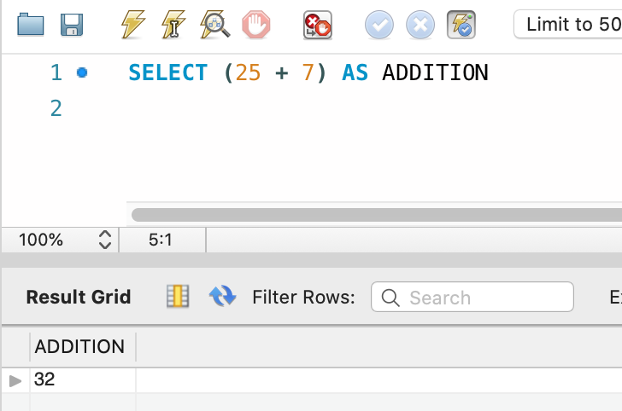
Numeric Function - Example - 1
The numerical_expression is used for a mathematical expression or any formula. Following is a simple example showing the usage of SQL Numeric Expressions
Syntax:
SELECT (25 + 7) AS ADDITION
Output:
ADDITION
32

Slide 99
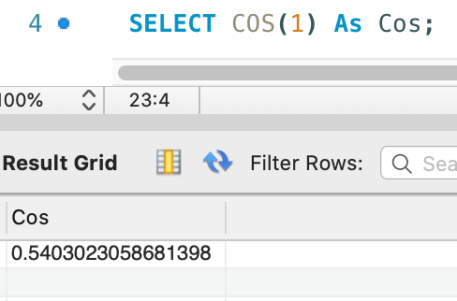
Numeric Function - Example - 2
The numerical_expression is used for a mathematical expression or any formula. Following is a simple example showing the usage of SQL Numeric Expressions
Syntax:
SELECT COS(1) As Cos;
Output:
Cos
0.5403023058681398

Slide 100
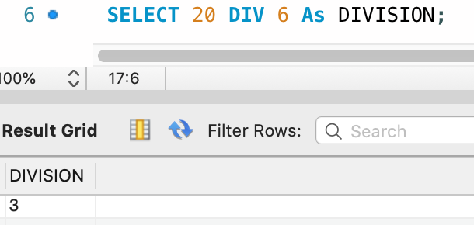
Numeric Function - Example - 3
The numerical_expression is used for a mathematical expression or any formula. Following is a simple example showing the usage of SQL Numeric Expressions
Syntax:
SELECT 20 DIV 6 As DIVISION;
Output:
DIVISION
3

Slide 101
More Numeric Functions
Following are the numeric functions defined in SQL
Functions | Meaning
ABS | It returns the absolute value of a number
ACOS | It returns the cosine of a number
ASIN | It returns the arc sine of a number
ATAN | It returns the arc sine of a number
CEIL | It returns the smallest integer value that is greater than or equal to a number
CEILING | It returns the smallest integer value that is greater than or equal to a number

Slide 102
More Numeric Functions
Functions | Meaning
COS | It returns the cosine of a number
COT | It returns the cotangent of a number
DEGREES | It converts a radian value into degrees
DIV | It is used for integer division
EXP | It returns e raised to the power of number
FLOOR | It returns the largest integer value that is less than or equal to a number

Slide 103
More Numeric Functions
Functions | Meaning
GREATEST | It returns the greatest value in a list of expressions
LEAST | It returns the smallest value in a list of expressions
LN | It returns the natural logarithm of a number
LOG10 | It returns the base-10 logarithm of a number
LOG2 | It returns the base-2 logarithm of a number
MOD | It returns the remainder of n divided by m

Slide 104
More Numeric Functions
Functions | Meaning
PI | It returns the value of PI displayed with 6 decimal places
POW | It returns m raised to the nth power
RADIANS | It converts a value in degrees to radians
RAND | It returns a random number
ROUND | It returns a number rounded to a certain number of decimal places
SIGN | It returns a value indicating the sign of a number

Slide 105
More Numeric Functions
Functions | Meaning
SIN | It returns the sine of a number
SQRT | It returns the square root of a number
TAN | It returns the tangent of a number
ATAN2 | It returns the arctangent of the x and y coordinates, as an angle and expressed in radians
TRUNCATE | This doesn’t work for SQL Server. It returns 7.53635 truncated to 2 places right of the decimal point

Slide 106
String Functions

Slide 107
More Numeric Functions
String functions are used to perform an operation on input string and return an output string
Following are the string functions defined in SQL
Functions | Meaning
ASCII | Return the ASCII code value of a character
CHAR | Convert an ASCII value to a character
CHARINDEX | Search for a substring inside a string starting from a specified location and return the position of the substring

Slide 108
More Numeric Functions
Functions | Meaning
CONCAT | Join two or more strings into one string
CONCAT_WS | Concatenate multiple strings with a separator into a single string
DIFFERENCE | Compare the SOUNDEX() values of two strings
FORMAT | Return a value formatted with the specified format and optional culture
LEFT | Extract a given a number of characters from a character string starting from the left

Slide 109
More Numeric Functions
Functions | Meaning
LEN | Return a number of characters of a character string
LOWER | Convert a string to lowercase
LTRIM | Return a new string from a specified string after removing all leading blanks
NCHAR | Return the Unicode character with the specified integer code, as defined by the Unicode standard
PATINDEX | Returns the starting position of the first occurrence of a pattern in a string

Slide 110
More Numeric Functions
Functions | Meaning
QUOTENAME | Returns a Unicode string with the delimiters added to make the input string a valid delimited identifier
REPLACE | Replace all occurrences of a substring, within a string, with another substring
REPLICATE | Return a string repeated a specified number of times
REVERSE | Return the reverse order of a character string
RIGHT | Extract a given a number of characters from a character string starting from the right

Slide 111
More Numeric Functions
Functions | Meaning
RTRIM | Return a new string from a specified string after removing all trailing blanks
REPLACE | Replace all occurrences of a substring, within a string, with another substring
SOUNDEX | Return a four-character (SOUNDEX) code of a string based on how it is spoken
SPACE | Returns a string of repeated spaces
STR | Returns character data converted from numeric data

Slide 112
More Numeric Functions
Functions | Meaning
STRING_AGG | Concatenate rows of strings with a specified separator into a new string
STRING_ESCAPE | Escapes special characters in a string and returns a new string with escaped characters
STRING_SPLIT | A table-valued function that splits a string into rows of substrings based on a specified separator
STUFF | Delete a part of a string and then insert another substring into the string starting at a specified position

Slide 113
More Numeric Functions
Functions | Meaning
SUBSTRING | Extract a substring within a string starting from a specified location with a specified length
TRANSLATE | Replace several single-characters, one-to-one translation in one operation
TRIM | Return a new string from a specified string after removing all leading and trailing blanks
UPPER | Convert a string to uppercase

Slide 114
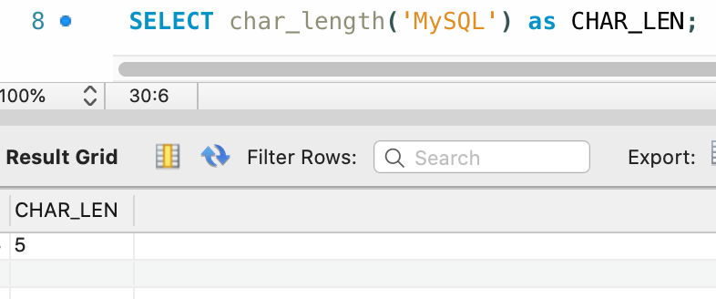
String Function - Example - 1
CHAR_LENGTH(): Doesn’t work for SQL Server. Use LEN() for SQL Server. This function is used to find the length of a word.
Syntax:
SELECT char_length('MySQL') as CHAR_LEN;
Output:
CHAR_LEN
5

Slide 115
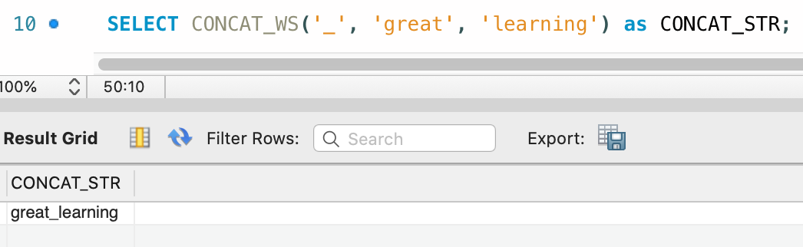
String Function - Example - 2
CONCAT_WS(): This function is used to add two words or strings with a symbol as concatenating symbol
Syntax:
SELECT CONCAT_WS('_', 'great', 'learning') as CONCAT_STR;
Output:
CONCAT_STR
great_learning

Slide 116
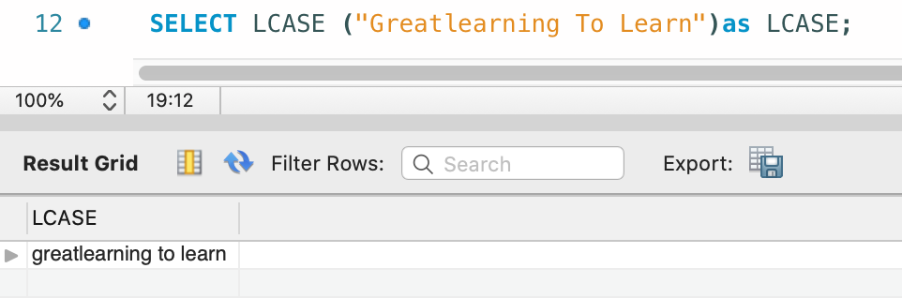
String Function - Example - 3
LCASE(): This function is used to convert the given string into lower case
Syntax:
SELECT LCASE ("Greatlearning To Learn")as LCASE;
Output:
LCASE
greatlearning to learn

Slide 117
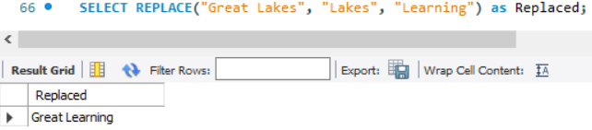
String Function - Example - 4
REPLACE(): This function replaces all occurrences of a substring within a string, with a new substring
Syntax:
SELECT REPLACE("Great Lakes", "Lakes", "Learning") as Replaced;
Output:
Replaced
Great Learning

Slide 118
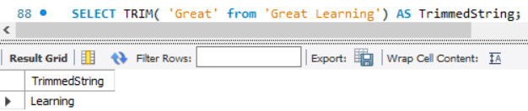
String Function - Example - 5
TRIM(): This function removes unwanted characters from a string
Syntax:
SELECT TRIM( 'Great' from 'Great Learning') AS TrimmedString;
Output:
TrimmedString
Learning

Slide 119
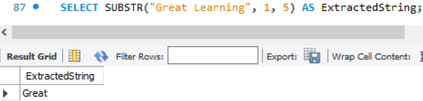
String Function - Example - 6
SUBSTR(): This function extracts a substring from a string
Syntax:
SELECT SUBSTR("Great Learning", 1, 5) AS ExtractedString;
Output:
ExtractedString
Great

Slide 120
DATE Function

Slide 121
Date Functions
The format of the date in table must be matched with the input date in order to insert. In various scenarios instead of date, datetime is used
In MySql the default date functions are:
Functions | Meaning
NOW | Returns the current date and time
CURDATE | Returns the current date
CURTIME | Returns the current time

Slide 122
Date Functions
Functions | Meaning
DATE | Extracts the date part of a date or date/time expression
EXTRACT | Returns a single part of a date/time
DATE_ADD | Adds a specified time interval to a date
DATE_SUB | Subtracts a specified time interval from a date
DATEDIFF | Returns the number of days between two dates
DATE_FORMAT | Displays date/time data in different formats

Slide 123
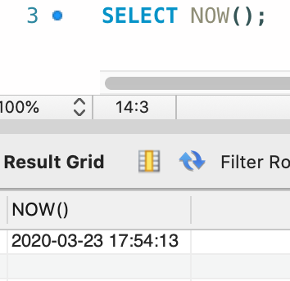
Date Function - Example - 1
NOW(): Returns the current date and time.
Syntax
SELECT NOW();
Output:
NOW()
2020-03-23 17:54:13

Slide 124
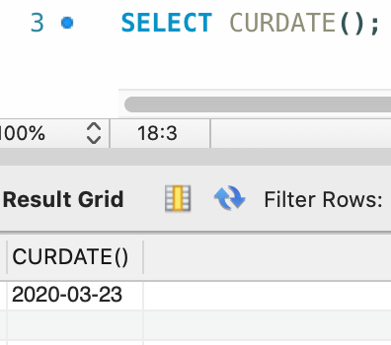
Date Function - Example - 2
CURDATE(): Returns the current date.
Syntax
SELECT CURDATE();
Output:
CURDATE()
2020-03-23

Slide 125
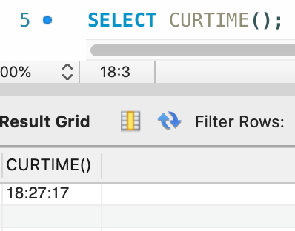
Date Function - Example - 3
CURTIME(): Returns the current time
Syntax
SELECT CURTIME();
Output:
CURTIME()
18:27:17

Slide 126
BIN Function

Slide 127
BIN Function - Syntax
MySQL BIN() returns the corresponding string representation of the binary value of a BIGINT number
Syntax:
BIN(num1)
Argument:
Name | Description
num1 | A number whose binary value is to be retrieved

Slide 128
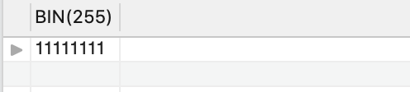
BIN Function - Example
The following MySQL statement returns the string representation of 255, i.e. '11111111'
Syntax:
Select BIN(255);
Output:

Slide 129
CAST Function

Slide 130
CAST Function - Syntax
The CAST() function converts a value (of any type) into the specified datatype
Syntax:
CAST(value AS datatype)
Argument:
Parameter | Description
value | Required. The value to convert
datatype | Required. The datatype to convert to

Slide 131
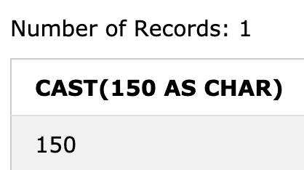
CAST Function - Example - 1
Converting a value to a CHAR data type
Syntax:
SELECT CAST(150 AS CHAR);
Output:

Slide 132
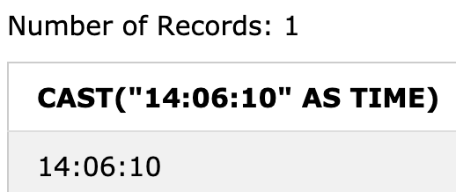
CAST Function - Example - 2
Converting a value to a TIME datatype
Syntax:
SELECT CAST("14:06:10" AS TIME);
Output:

Slide 133
COALESCE Function

Slide 134
COALESCE Function - Syntax
The COALESCE() function returns the first non-null value in a list
Syntax:
COALESCE(val1, val2, ...., val_n)
Parameter Values:
Parameter | Description
val1, val2, val_n | Required. The values to test

Slide 135
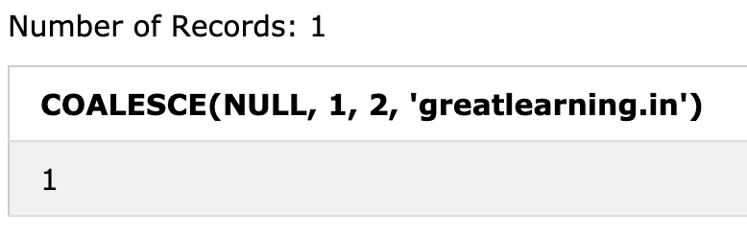
COALESCE Function - Example
Return the first non-null value in a list
SELECT COALESCE(NULL, 1, 2, 'greatlearning.in');
Output:
The first value after the NULL value is ‘1’ , so the output is 1

Slide 136
Sorting Query Result

Slide 137
Sorting Query Results
Consider the following table for the study:

Slide 138
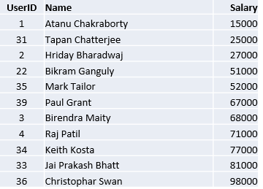
Sorting Query Results
The order by clause causes the tuples in the result of a query to appear in sorted order
Let us write a query which will show the users according to the ascending order of their salary.
SELECT UserID, Name, Salary FROM tblUser ORDER BY Salary
Output:
By default, the order by clause lists items in ascending order.

Slide 139
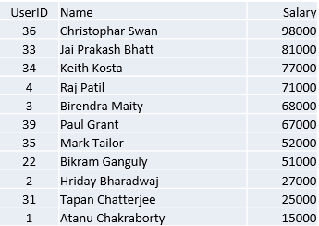
Sorting Query Results
To specify the sort order we used: desc for descending order or asc for ascending order
Now let us see an example to show the users according to the descending order of their salary
SELECT UserID, Name, Salary FROM tblUser ORDER BY Salary desc
Output:

Slide 140
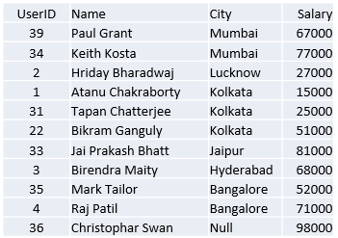
Sorting Query Results
Furthermore ordering can be performed on multiple attributes.
Suppose we wish to order the entire tblUser relation in ascending order of City and then descending order of amount. Then we express this query in SQL as follows.
SELECT UserID, Name, Salary FROM tblUser ORDER BY City desc, Salary asc
Output:

Slide 141
Thank You

